Slide 1
Hotel Management system
This project is made with java , java API(java swings), database Mysql . The project contain different classes we have brief description of each class function below .

Slide 2
Introduction to java :
Java is a class-based, object-oriented programming language that is designed to have as few implementation dependencies as possible. It is intended to let application developers write once, and run any where (WORA), meaning that compiled Java code can run on all platforms that support Java without the need for recompilation. Java was first released in 1995 and is widely used for developing applications for desktop, web, and mobile devices. Java is known for its simplicity, robustness, and security features, making it a popular choice for enterprise-level applications.
JAVA was developed by James Gosling at Sun Microsystems Inc in the year 1995 and later acquired by Oracle Corporation. It is a simple programming language. Java makes 1riting, compiling, and debugging programming easy. It helps to create reusable code and modular programs. Java is a class-based, object-oriented programming language and is designed to have as fe1 implementation dependencies as possible. A general-purpose programming language made for developers to 1rite once run any1here that is compiled Java code can run on all platforms that support Java. Java applications are compiled to byte code that can run on any Java Virtual Machine. The syntax of Java is similar to c/c++.

Slide 3


Slide 4
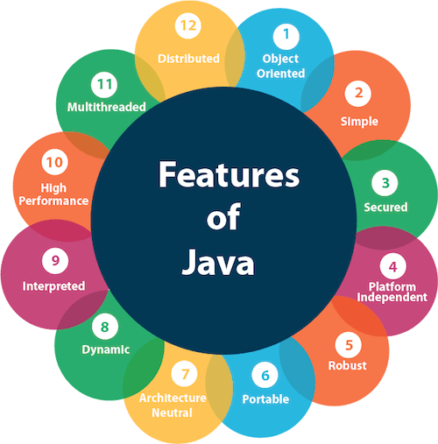
Features of Java :-
The primary objective of Java programming language creation was to make it portable, simple and secure programming language. Apart from this, there are also some excellent features which play an important role in the popularity of this language. The features of Java are also known as Java buzzwords.
A list of the most important features of the Java language is given below.
Fig :2.2

Slide 5
1.Simple
Java is very easy to learn, and its syntax is simple, clean and easy to understand. According to Sun Microsystem, Java language is a simple programming language because:
Java syntax is based on C++ (so easier for programmers to learn it after C++).
Java has removed many complicated and rarely-used features, for example, explicit pointers, operator overloading, etc.
There is no need to remove unreferenced objects because there is an Automatic Garbage Collection in Java.
2.Java is an object-oriented programming language. Everything in Java is an object. Object-oriented means we organize our software as a combination of different types of objects that incorporate both data and behavior.
Object-oriented programming (OOPs) is a methodology that simplifies software development and maintenance by providing some rules.
3.Secured
Java is best known for its security. With Java, we can develop virus-free systems. Java is secured because:
No explicit pointer
Java Programs run inside a virtual machine sandbox
Bytecode Verifier: It checks the code fragments for illegal code that can violate access rights to objects.
Security Manager: It determines what resources a class can access such as reading and writing to the local disk.
Classloader: Classloader in Java is a part of the Java Runtime Environment (JRE) which is used to load Java classes into the Java Virtual Machine dynamically

Slide 6
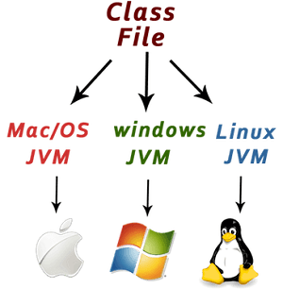
4.Platform independent :Java is platform independent because it is different from other languages like C, C++, etc. which are compiled into platform specific machines while Java is a write once, run anywhere language. A platform is the hardware or software environment in which a program runs.
There are two types of platforms software-based and hardware-based. Java provides a software-based platform.
The Java platform differs from most other platforms in the sense that it is a software-based platform that runs on top of other hardware-based platforms. It has two components:
Runtime Environment
API(Application Programming Interface)
Java code can be executed on multiple platforms, for example, Windows, Linux, Sun Solaris, Mac/OS, etc. Java code is compiled by the compiler and converted into bytecode. This bytecode is a platform-independent code because it can be run on multiple platforms, i.e., Write Once and Run Anywhere (WORA).

Slide 7
5.Robust
The English mining of Robust is strong. Java is robust because:
It uses strong memory management.
There is a lack of pointers that avoids security problems.
Java provides automatic garbage collection which runs on the Java Virtual Machine to get rid of objects which are not being used by a Java application anymore.
There are exception handling and the type checking mechanism in Java. All these points make Java robust.
6. Architecture-neutral
Java is architecture neutral because there are no implementation dependent features, for example, the size of primitive types is fixed.
In C programming, int data type occupies 2 bytes of memory for 32-bit architecture and 4 bytes of memory for 64-bit architecture. However, it occupies 4 bytes of memory for both 32 and 64-bit architectures in Java.
7. Portable
Java is portable because it facilitates you to carry the Java bytecode to any platform. It doesn't require any implementation.
8. High-performance
Java is faster than other traditional interpreted programming languages because Java bytecode is "close" to native code. It is still a little bit slower than a compiled language (e.g., C++). Java is an interpreted language that is why it is slower than compiled languages, e.g., C, C++, etc.
9. Distributed
Java is distributed because it facilitates users to create distributed applications in Java. RMI and EJB are used for creating distributed applications. This feature of Java makes us able to access files by calling the methods from any machine on the internet.

Slide 8
10. Multi-threaded
A thread is like a separate program, executing concurrently. We can write Java programs that deal with many tasks at once by defining multiple threads. The main advantage of multi-threading is that it doesn't occupy memory for each thread. It shares a common memory area. Threads are important for multi-media, Web applications, etc
11. Dynamic
Java is a dynamic language. It supports the dynamic loading of classes. It means classes are loaded on demand. It also supports functions from its native languages, i.e., C and C++.
Java supports dynamic compilation and automatic memory management (garbage collection)
JVM :-
JVM (Java Virtual Machine) is an abstract machine. It is called a virtual machine because it doesn't physically exist. It is a specification that provides a runtime environment in which Java byte code can be executed. It can also run those programs 1hich are 1ritten in other languages and compiled to Java byte code.
JVMs are available for many hardware and software platforms. JVM, JRE, and JDK are platform dependent because the configuration of each OS is different from each other. However, Java is platform independent. There are three notions of the JVM: specification, implementation, and instance.

Slide 9
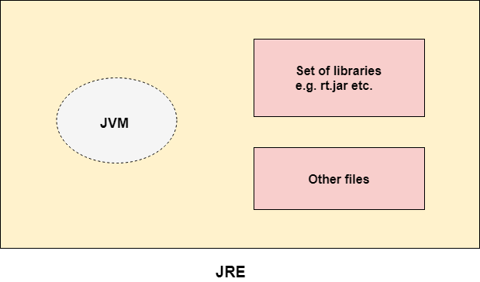
JRE :-
JRE is an acronym for Java Runtime Environment. It is also 1ritten as Java RTE. The Java Runtime Environment is a set of software tools which are used for developing Java applications. It is used to provide the runtime environment. It is the implementation of JVM. It physically exists. It contains a set of libraries + other files that JVM uses at runtime.
The implementation of JVM is also actively released by other companies besides Sun Micro Systems

Slide 10
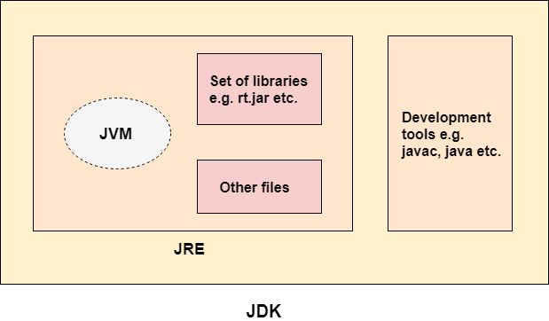
JDK :-
JDK is an acronym for Java Development Kit. The Java Development Kit (JDK) is a software development environment which is used to develop Java applications and applets. It physically exists. It contains JRE + development tools.
JDK is an implementation of any one of the below given Java Platforms released by Oracle Corporation:
Standard Edition Java Platform
Enterprise Edition Java Platform
Micro Edition Java Platform
The JDK contains a private Java Virtual Machine (JVM) and a fe1 other resources such as an interpreter/loader (java), a compiler (java), an archive (jar), a documentation generator (Java doc), etc. to complete the development of a Java Application.

Slide 11
Java Swing Tutorial
Java Swing tutorial is a part of Java Foundation Classes (JFC) that is used to create window-based applications. It is built on the top of AWT (Abstract Windowing Toolkit) API and entirely written in java.
Unlike AWT, Java Swing provides platform-independent and lightweight components.
The javax.swing package provides classes for java swing API such as JButton, JTextField, JTextArea, JRadioButton, JCheckbox, JMenu, JColorChooser etc.
Difference between AWT and Swing
There are many differences between java awt and swing that are given below.
No. | Java AWT | Java Swing
1) | AWT components are platform-dependent. | Java swing components are platform-independent.
2) | AWT components are heavyweight. | Swing components are lightweight.
3) | AWT doesn't support pluggable look and feel. | Swing supports pluggable look and feel.
4) | AWT provides less components than Swing. | Swing provides more powerful components such as tables, lists, scrollpanes, colorchooser, tabbedpane etc.
5) | AWT doesn't follows MVC(Model View Controller) where model represents data, view represents presentation and controller acts as an interface between model and view. | Swing follows MVC.

Slide 12
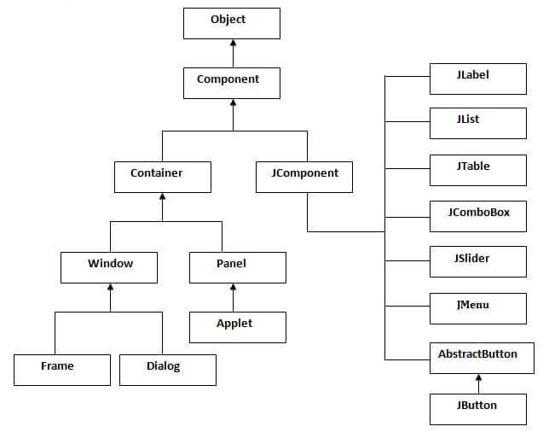
Hierarchy of Java Swing classes
The hierarchy of java swing API is given below.

Slide 13
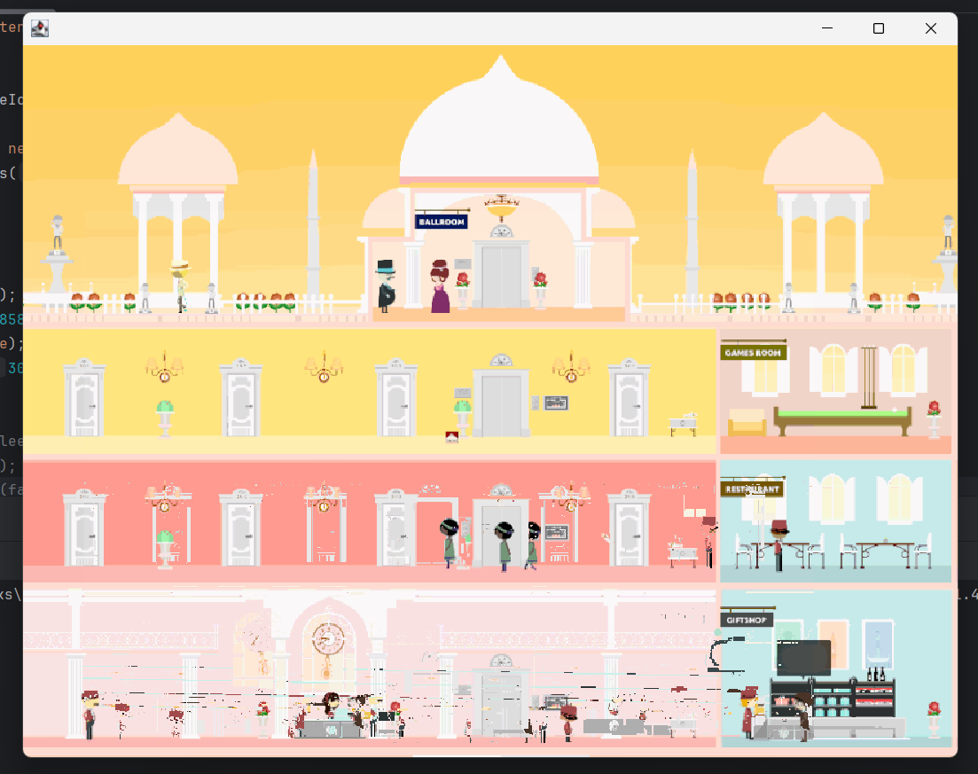
Brief description of each class and function of project(hotel management system):
1. Splash page
The splash class is designed to create a splash screen for an application,
displaying an image for a few seconds before launching a new login window
Key methods in class :
Image Loading: ImageIcon and ClassLoader.getSystemResource are used to load the splash image.
Display: JLabel and add method are used to display the image on the JFrame.
Timing: Thread.sleep is used to control the display duration of the splash screen.
Transition: Instantiating the login class transitions from the splash screen to the login screen.
Exception Handling: A try-catch block handles any potential exceptions during the thread sleep.

Slide 14
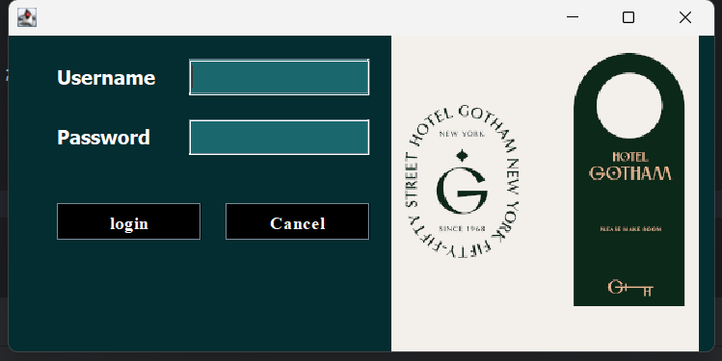
2.Login page: here the main login of the site portfolio type by the id’s which is in the database only
Component Creation: Labels, text fields, and buttons are created and configured for the login interface.
Layout Management: Absolute positioning is used for precise control over component placement.
Event Handling: Action listeners are added to buttons to handle login and cancel actions.
Database Interaction: SQL queries are used to validate user credentials.
Transition and Feedback: Successful login leads to the dashboard, while unsuccessful attempts show an error message.

Slide 15
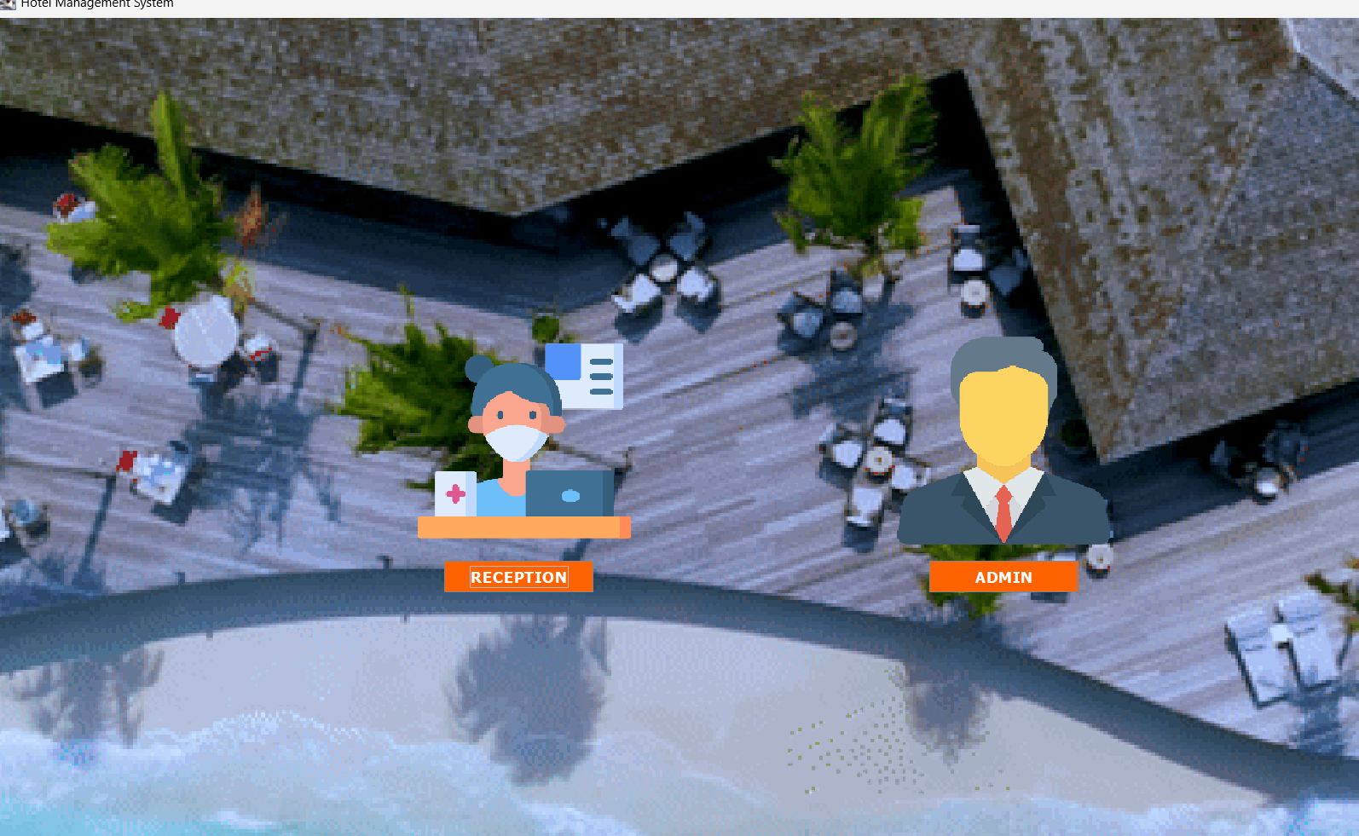
3: web page -> at third page we have to select the reception or admin only those person who have access in admin database are entered in admin and at reception every one entered.
At admin page there is 3 main option in which three classes where we can add room ,employee ,driver .
At reception page there is total 11 options which we can use to make a new customer ,check room, check drivers .

Slide 16
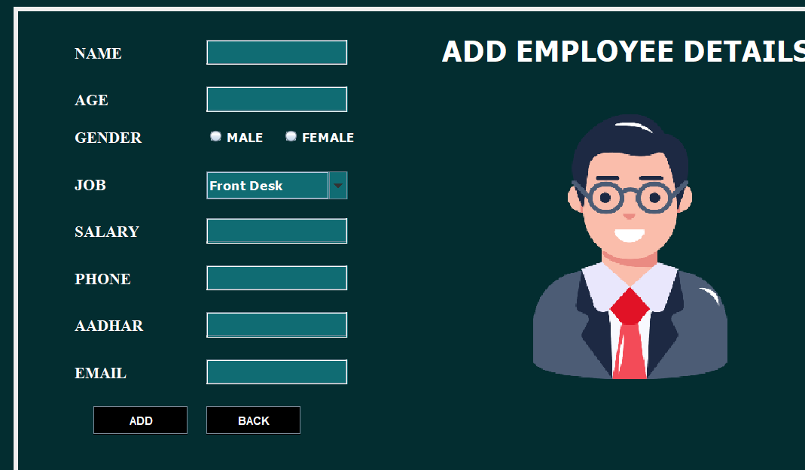
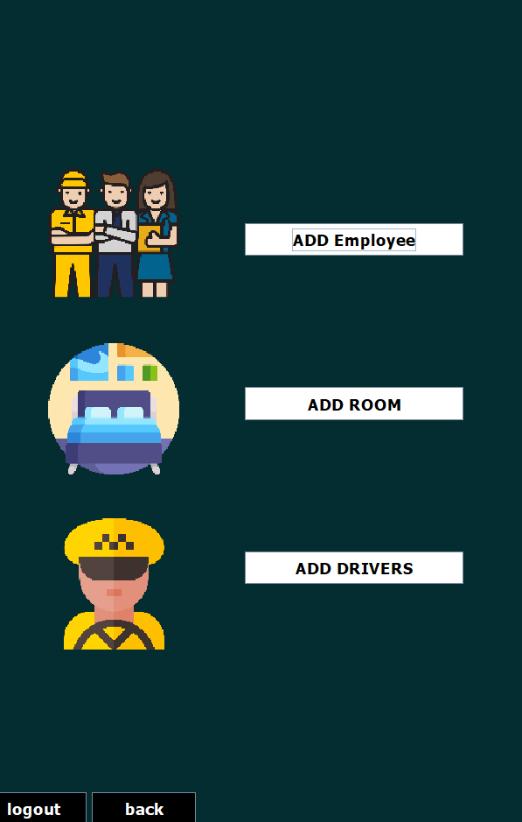
Now admin options ->

Slide 17
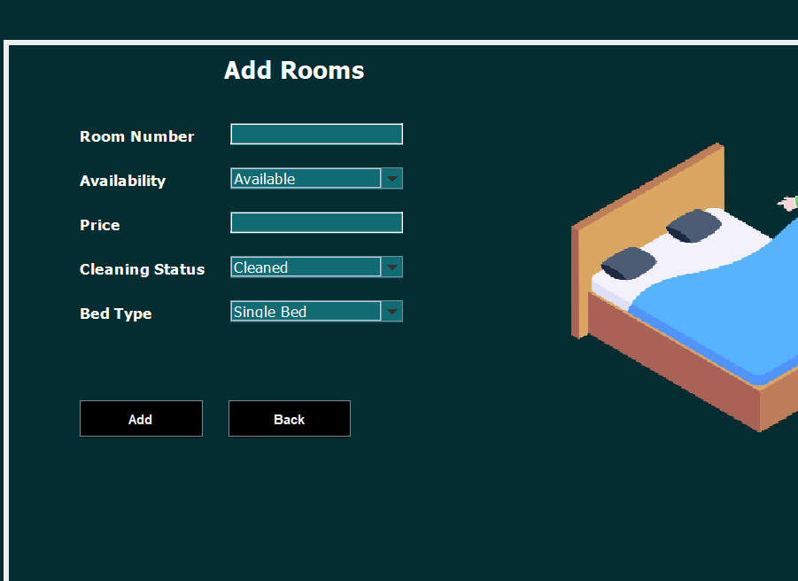
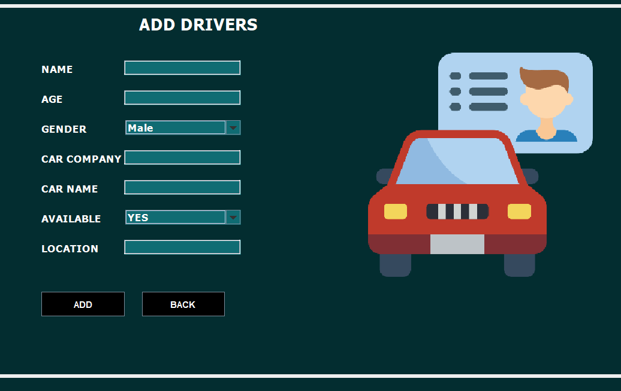
Add Room class
Add driver class

Slide 18

Now reception options :

Slide 19
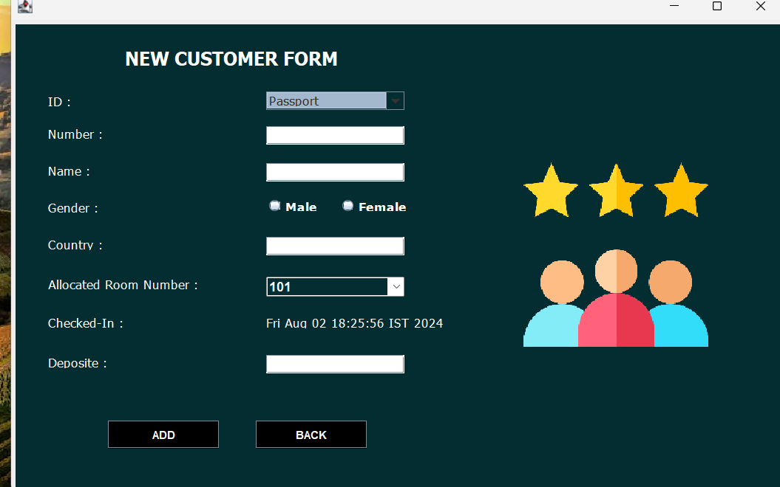
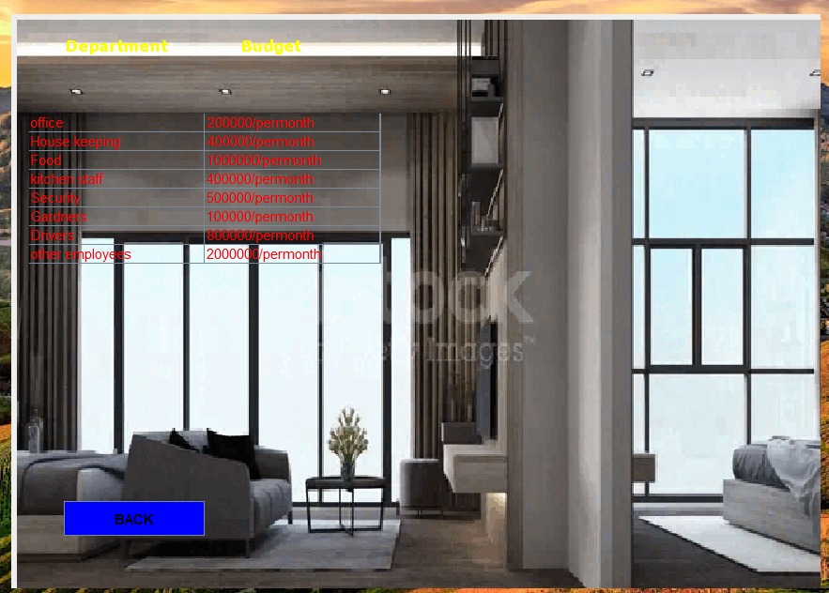
New customer form
Office info

Slide 20
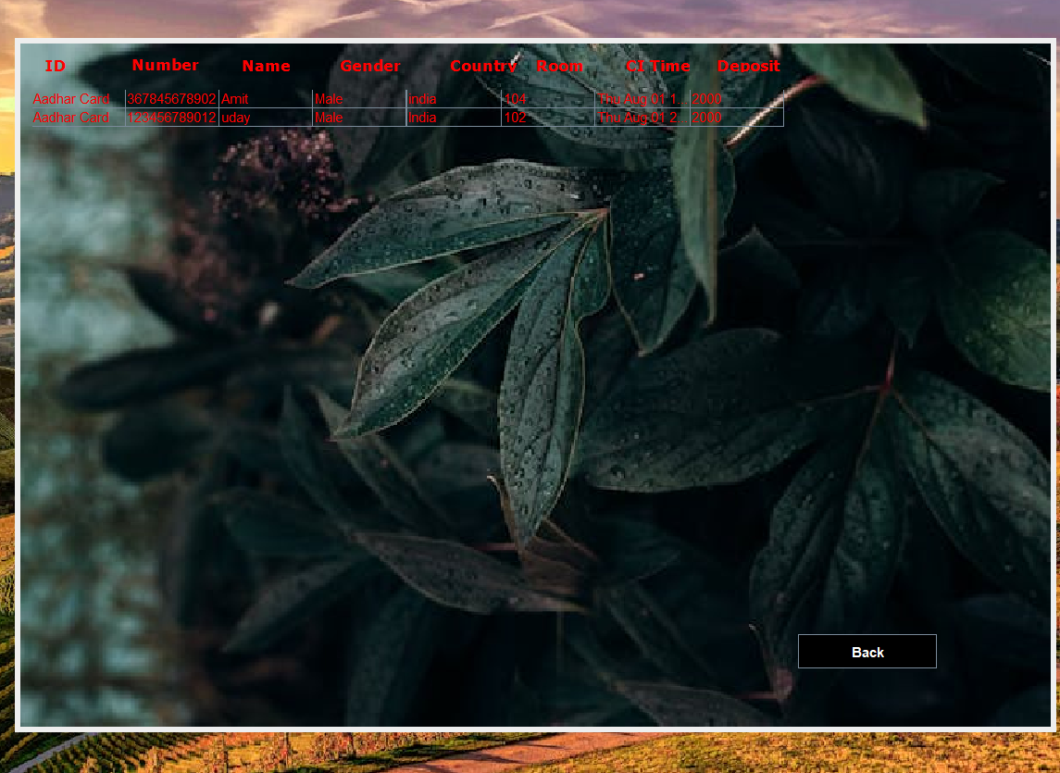


Slide 21
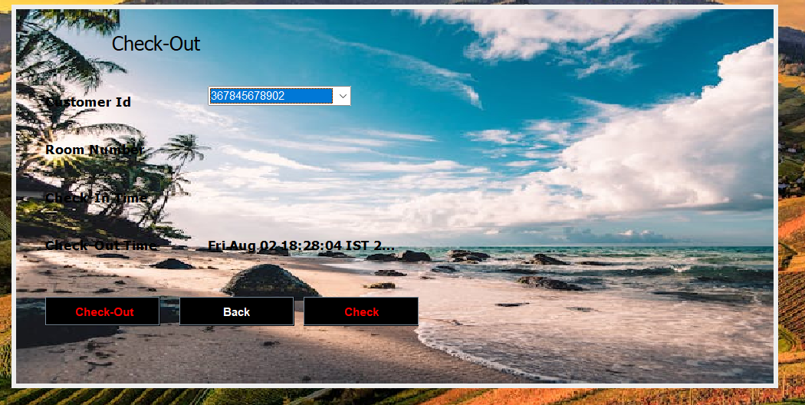
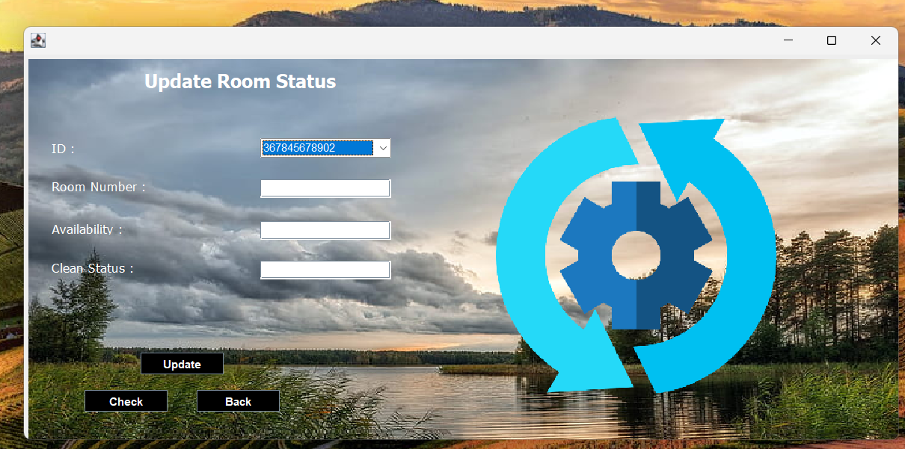
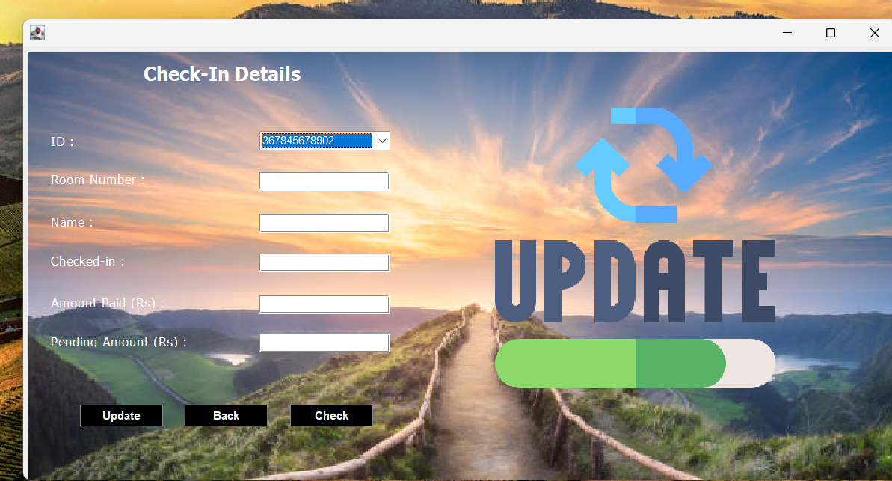

Slide 22
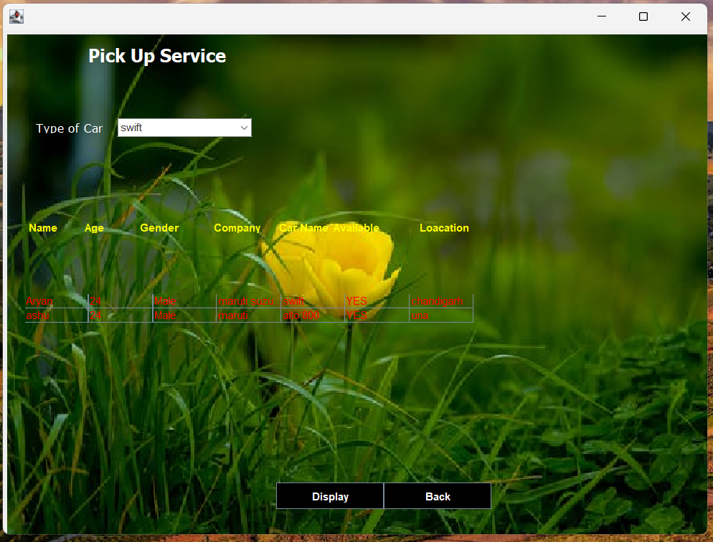
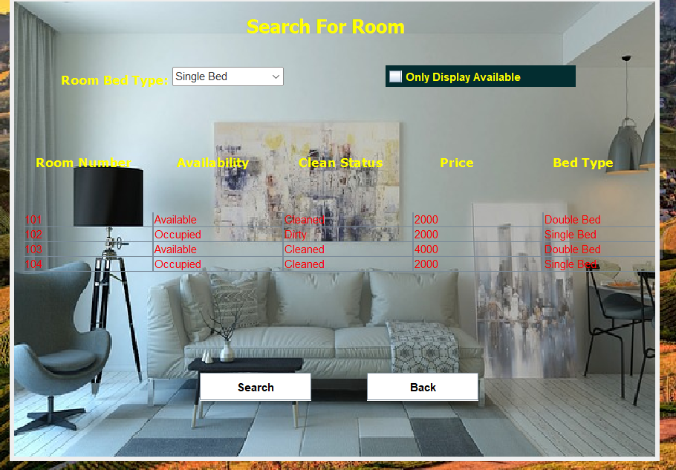

Slide 23
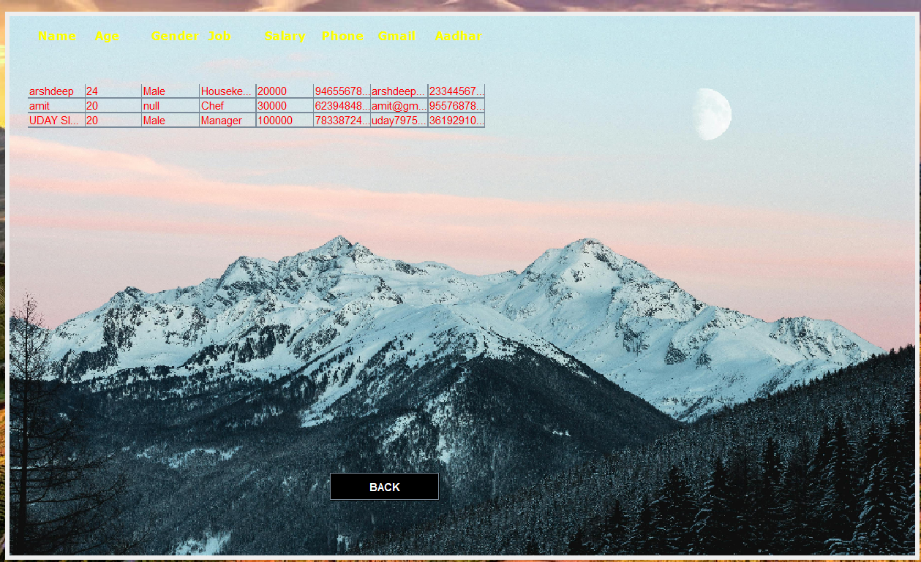

Slide 24
Java Swing
Swing provides a rich set of components for building GUIs. Here are some important classes and their key methods:
JFrame
setTitle(String title): Sets the title of the frame.
setSize(int width, int height): Sets the size of the frame.
setDefaultCloseOperation(int operation): Sets the operation that happens by default when the user initiates a "close" on the frame (e.g., JFrame.EXIT_ON_CLOSE).
setVisible(boolean b): Makes the frame visible or invisible.
add(Component comp): Adds a component to the frame.
getContentPane(): Returns the content pane of the frame.
JButton
setText(String text): Sets the text of the button.
addActionListener(ActionListener l): Adds an action listener to the button.
setIcon(Icon icon): Sets the icon of the button.
setEnabled(boolean b): Enables or disables the button.
JLabel
setText(String text): Sets the text of the label.
setIcon(Icon icon): Sets the icon of the label.
setHorizontalAlignment(int alignment): Sets the horizontal alignment of the label (e.g., JLabel.CENTER).
setForeground(Color color): Sets the foreground color of the label.
JTextField
setText(String text): Sets the text of the text field.
getText(): Returns the text from the text field.
setColumns(int columns): Sets the number of columns in the text field.
JPasswordField
setEchoChar(char c): Sets the character to be echoed in the password field.
getPassword(): Returns the password entered in the password field as an array of characters.

Slide 25
JPanel
setLayout(LayoutManager mgr): Sets the layout manager for the panel.
add(Component comp): Adds a component to the panel.
setBackground(Color bg): Sets the background color of the panel.
Java AWT
AWT provides the foundational classes for building GUIs and includes components, layout managers, and event handling. Here are some key methods:
Frame
setTitle(String title): Sets the title of the frame.
setSize(int width, int height): Sets the size of the frame.
setVisible(boolean b): Makes the frame visible or invisible.
add(Component comp): Adds a component to the frame.
setLayout(LayoutManager mgr): Sets the layout manager for the frame.
setBackground(Color bg): Sets the background color of the frame.
Button
setLabel(String label): Sets the label of the button.
addActionListener(ActionListener l): Adds an action listener to the button.
setEnabled(boolean b): Enables or disables the button.

Slide 26
Label
setText(String text): Sets the text of the label.
setAlignment(int alignment): Sets the alignment of the label (e.g., Label.CENTER).
setForeground(Color color): Sets the foreground color of the label.
TextField
setText(String text): Sets the text of the text field.
getText(): Returns the text from the text field.
setColumns(int columns): Sets the number of columns in the text field.
Panel
setLayout(LayoutManager mgr): Sets the layout manager for the panel.
add(Component comp): Adds a component to the panel.
setBackground(Color bg): Sets the background color of the panel

Slide 27
Layout Managers
Both Swing and AWT use layout managers to control the arrangement of components within containers.
BorderLayout
add(Component comp, Object constraints): Adds a component with a specific constraint (e.g., BorderLayout.NORTH).
FlowLayout
setAlignment(int align): Sets the alignment for the layout (e.g., FlowLayout.LEFT).
setHgap(int hgap): Sets the horizontal gap between components.
setVgap(int vgap): Sets the vertical gap between components.
GridLayout
setRows(int rows): Sets the number of rows in the layout.
setColumns(int cols): Sets the number of columns in the layout.
setHgap(int hgap): Sets the horizontal gap between components.
setVgap(int vgap): Sets the vertical gap between components.

Slide 28


